Slide 1
COVID-19 Impacts around the world
Jahangir Dewan, Sofia Mbega, Cody Miracle & Sajad Yarzada

Slide 2
Questions we explored
How has covid-19 impacted the world? What countries have the highest # of Cases and # Deaths?
Does population density have any impact on the rise of COVID-19 cases or deaths?
Is there a relationship between life-expectancy and rise of COVID-19 in countries?
Does Diabetes Prevalence have any relationship with the rise of COVID-19 deaths?
Do countries with fewer hospital beds have a higher # of deaths?
Do male or female smokers have a higher chance of death of COVID-19?

Slide 3
”
—Dr. Michael J. Ryan, WHO Informal Advisory Group.
“We need to learn the lessons that are being shown from this virus”

Slide 4
Data Cleanup & Analysis Process
01
02
03
Searched for complete and updated dataset that included key research question indicators
Created a repo in Github, uploaded the owid_covid_main data file as the basis for the work
Removed the NaN values using dropna() to get a new clean file
04
05
06
New DataFrame was created to include the main columns needed to answer the research questions
Using groupby and sum() fucntion total case # and total deaths were calculated for all locations
A series of pie charts and regression analysis were conducted to find the answer for research questions

Slide 5
Data set
Here is the link to the dataset from “Our World in Health” for all covid-19 data as of September 28,2020:
https://github.com/jjjdewan/ucb-data-visualization-msgrp-project1-covid-19/blob/master/Resources/owid-covid-data_updated_main.csv

Slide 6
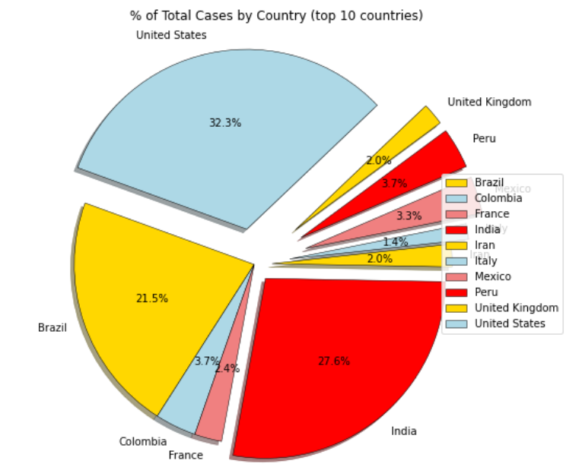
Total cases by country (top 10)
Top 5 Cases by Country
United State: 7,115,046
India: 6, 074, 702
Brazil: 4, 732,309
Russia: 1,151,438
Colombia: 813,056

Slide 7
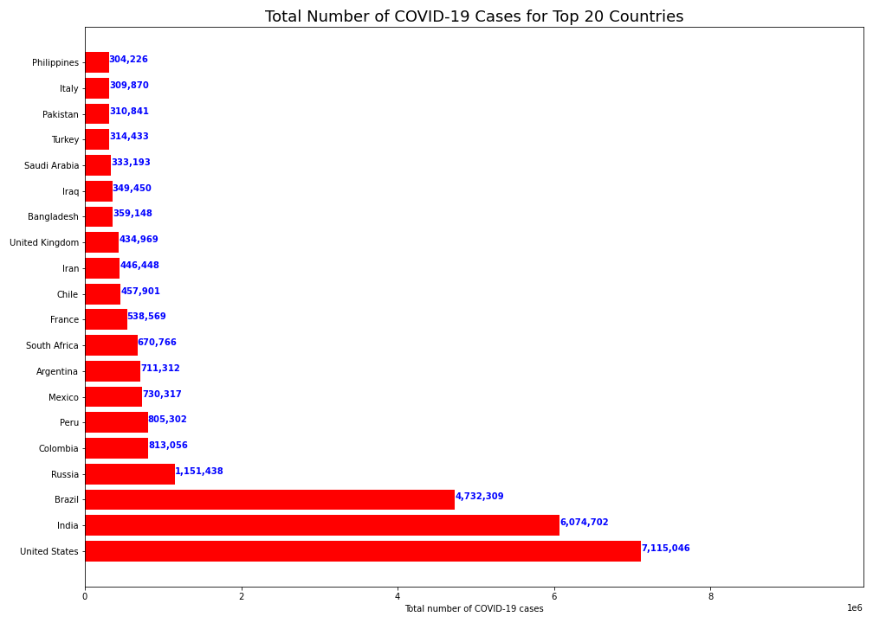
Total cases by country (top 10)

Slide 8
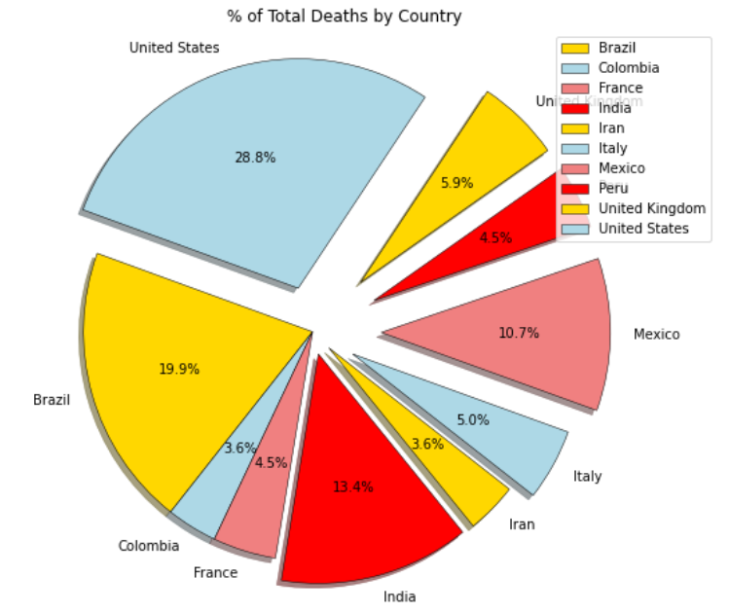
Total death by country (top 10)
Top 3 Deaths by Country
United States: 204,75
India: 141,741
Brazil: 95, 542

Slide 9
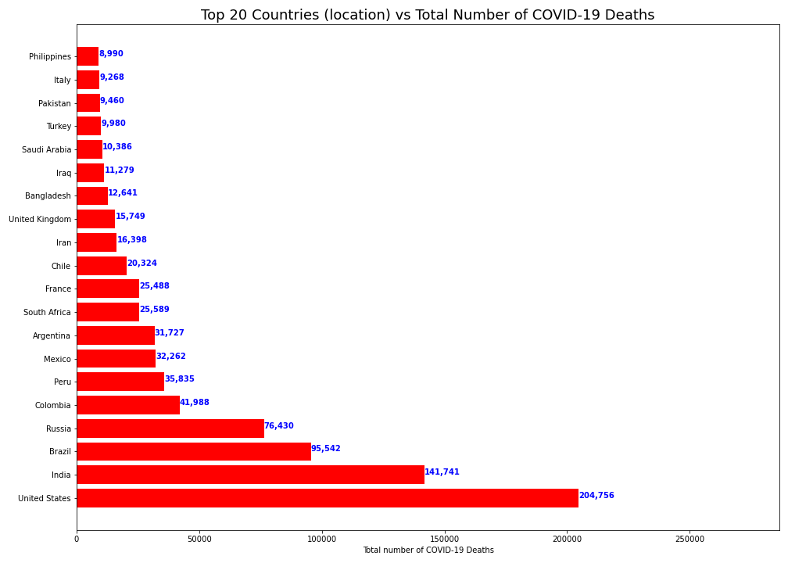
Total death by country (top 10)

Slide 10
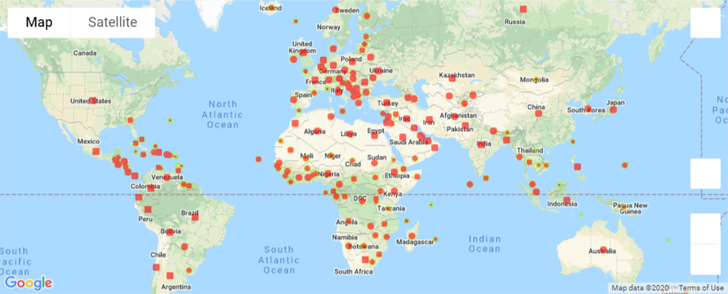
Heat Map of Total Cases by Country

Slide 11
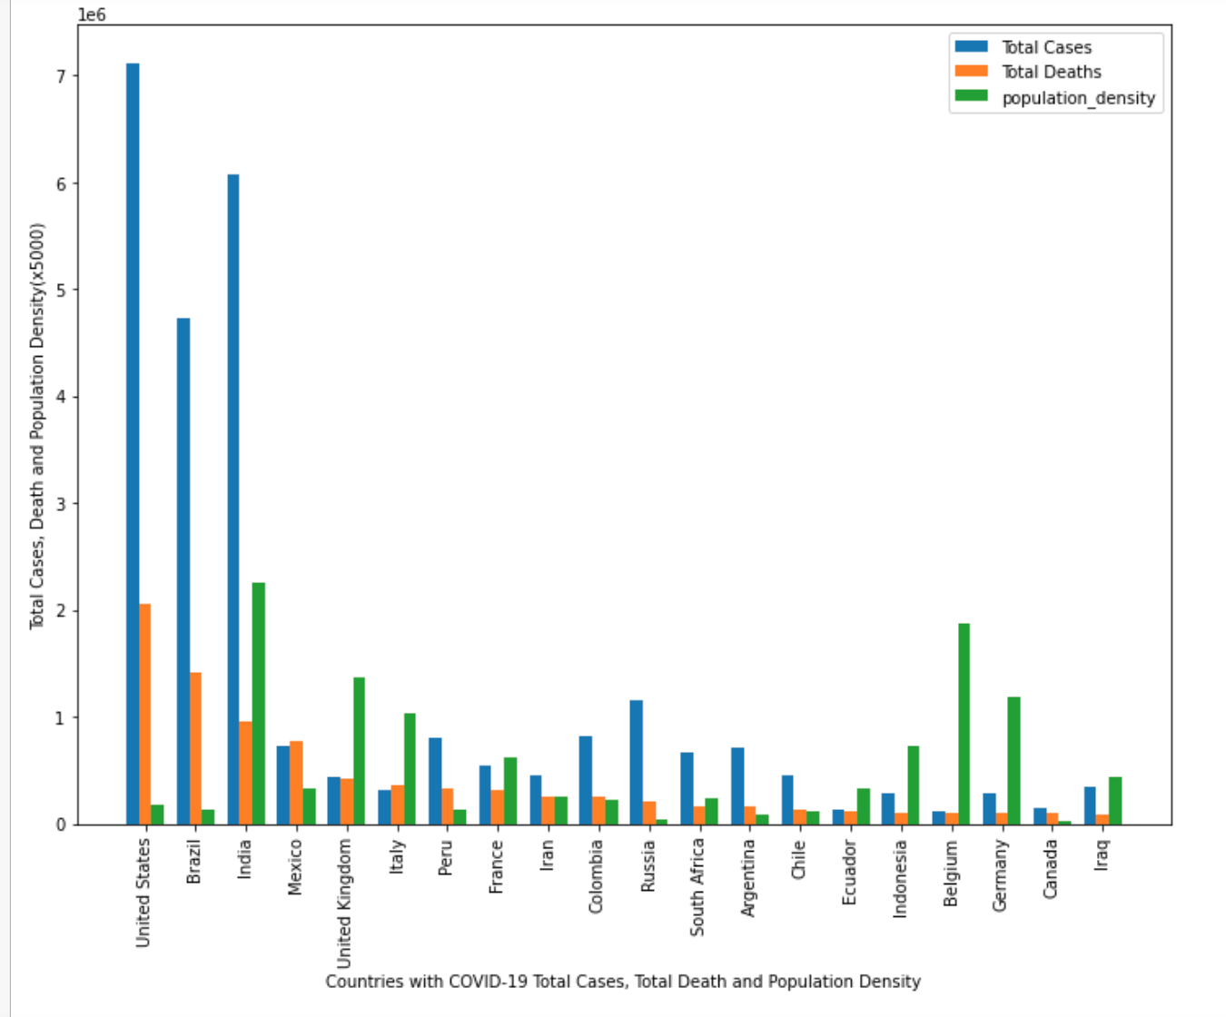
total cases, total deaths and population density
The effects of population density on covid-19 cases and deaths varies
There is not a direct relation of a country's population density and its total cases or deaths.
For example, despite the US having a lower population density has the highest # of cases
In comparison, Belgium has a high population density, but a low number of cases and deaths.

Slide 12
Our Tested hypothesis
Hypothesis Testing:
Hypothesis: Highly dense continents are mostly affected by Covid-19 due to closer proximity of potential carriers.
Analysis:
Our calculated Degree of Freedom = 5
Confidence Interval = 95%
Critical Value = 11.070497693516351
Conclusion:
The Chi-square value exceeds the critical value, which means the statistically significant but we cannot accept the Null Hypothesis because the P value is 0
Therefore, Population density of the continent does not contribute to the spread of Covid

Slide 13
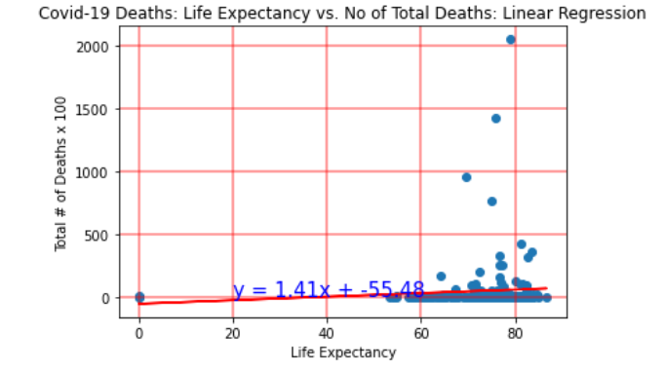
Life expectancy vs death rate
Most countries have a life expectancy in the range of 60-80 years old.
The r value of life expectancy to the total number of deaths is 0.08
There is a small positive correlation between the countries who have a higher life expectancy due to the old age and the total # of deaths by Covid
Elderly population are more vulnerable to Covid related deaths but there is not a strong correlation represented in the r value. This may be due to the low mortality rate in most countries.

Slide 14
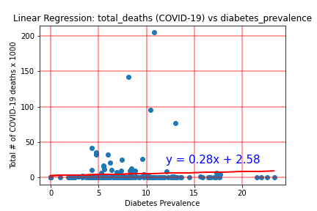
Diabetes prevalence vs Death Rate
The r value of diabetes prevalence to the total number of COVID-19 deaths is 0.09
There is a weak positive correlation between the countries who have a higher diabetes prevalence rate and the total # of cases by Covid
Countries who have higher rates of diabetes have slightly more vulnerable to COVID-19

Slide 15
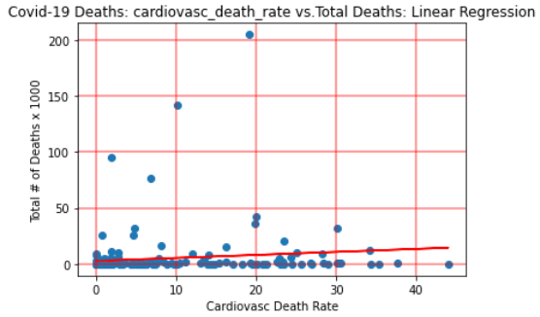
Female Smokers vs Total deaths
The r-value between female smokers and the total deaths of a country is 0. 13
There was still a weak correlation, but it was the highest of all variables tested. There’s no obvious reason for this, and more research would need to be done.

Slide 16
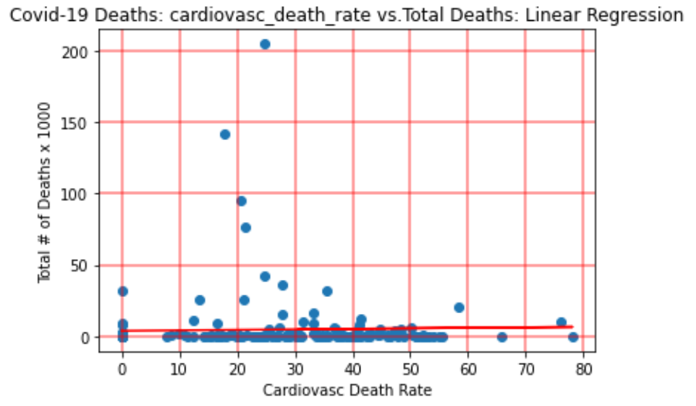
Male smokers vs Death rate
The r-value between male smoker cases and the death rate is 0.03.
The r-value for male smokers and female smokers is quite different. There is no apparent reason for this, and could be different enough for additional research to be done to discover this discrepancy.

Slide 17
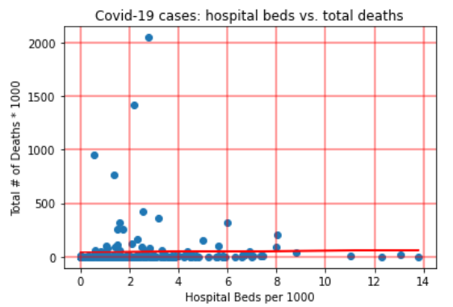
Availability of hospital beds vs total deaths
The r value is 0.02
There is a weak but positive correlation between availability of hospital beds and the total # of covid-deaths
Countries which have lower beds available in hospitals, have a slightly higher death rate

Slide 18
Summary
A summary of key highlights:
The United States has both the highest # of cases and highest # of deaths
Countries with a higher expectancy life have a slightly higher mortality rate
Countries with a higher Diabetes Prevalence rate have slightly more deaths
Countries with less hospital facilities have a slightly higher # of deaths

Slide 19
Conclusion
There seems to be a pattern of positive but weak correlations between the different variables in COVID-19 cases and deaths.
The things that most people already knew about the virus such as cases among elderly populations or pre-existing conditions would have higher death rates are true, but worldwide the correlation is weak..
One conclusion that we can extrapolate from these findings is that even though the research we conducted came back positive, it may have had weak correlation because of low mortality rates compared to cases. Since there are so many more cases than deaths, it may seem as if there’s not a significant relationship, but as we know for the most part this is not exactly true.
This does not mean that one should look at COVID-19 less seriously. There are still long-term effects that could affect a person's health for life. Until more research is conducted and published, the current heath recommendations should be followed.

Slide 20

THANKS!
Do you have any questions?

